Slide 1

CWB Circle 1
Prepared by Kalpana Kanthasamy

Slide 2
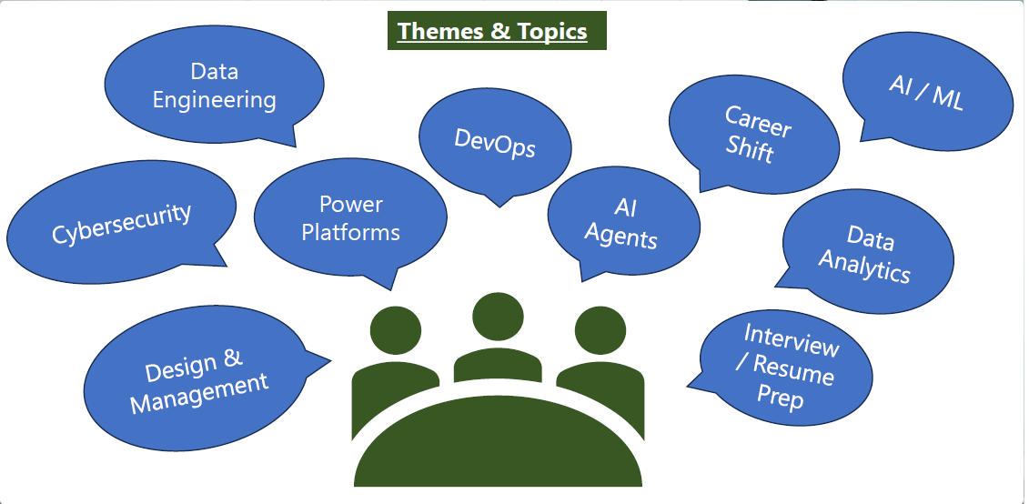

Slide 3
Ice Breaking Session
  One-Line Intro ( but please do not stop with one line….continue with more than that )
  If you shy…you can speak about these stuffs :-
    Tech Stack
    Dark mode 🌙 vs Light mode ☀️
    Tabs 🗂️ vs Windows 🪟
    Cloud ☁️ vs On-prem 🖥️
    Linux 🐧 vs Windows 🪟 vs macOS 🍎
  About ME

Slide 4
My plan ( Open to discussion )
1.5 hours
  45 minutes for technical demos, questions, applications and technical interview questions.
  15 minutes ( mentee’s present ).
  0.5 hours for non-technical questions..working ethics, teamwork, behavioral questions, imposter syndrome.
  0.01 minute – Task for next meetup.
  For the rest…we have whatsapp..
  I might not be able to answer your questions on the spot..cause I need to GOOGLE too..but I will and I should be able to explain to you in the next meeting.

Slide 5
SQL and No SQL
SQL or NoSQL – which of these you have experienced in…have you used it.
Cloud vs On-Premise…how many of you all have seen it and worked on it.
  Azure Cloud
  AWS
  And others..
  NoSQL Databases ( MongoDB, Azure Cosmos DB, DynamoDB, Cassandra, Redis )
  SQL Database ( MySQL, PostgreSQL, SQL Server, Oracle, Azure SQL Database )
  Which One Should I Learn First?
  👉 SQL first (easier to understand structure and relationships)
  👉 Then NoSQL (modern cloud apps)

Slide 6
Differences
Feature | SQL | NoSQL
Structure | Tables (rows/columns) | Documents, Key-Value, Graph
Schema | Fixed | Flexible
Scaling | Vertical | Horizontal
Transactions | Strong (ACID) | Eventual consistency
Use Case | Banking, ERP | Big data, real-time apps
NoSQL is named like this because it basically follows the opposite approach of SQL databases.
No schemas
No relations
That's how you could summarize it.
Instead, you structure data in collections (= tables in the SQL world). Records are now called documents.
But it's not just about the naming, there is a core difference: You can put data of different structure into the same collection. You couldn't do that in the SQL world - each table had a clear schema there

Slide 7
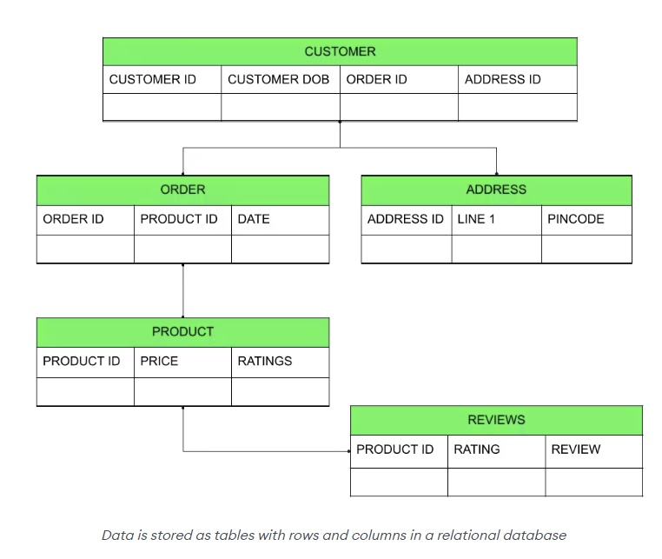
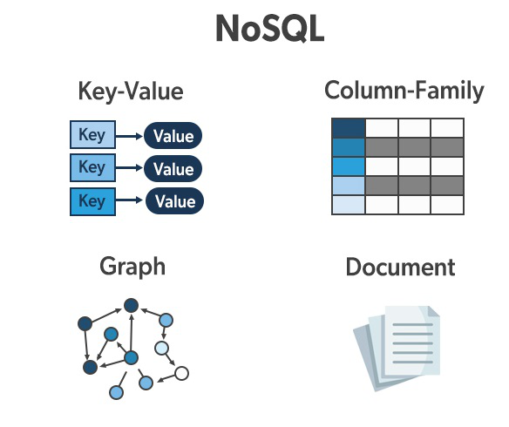
Structure
SQL | No SQL

Slide 8
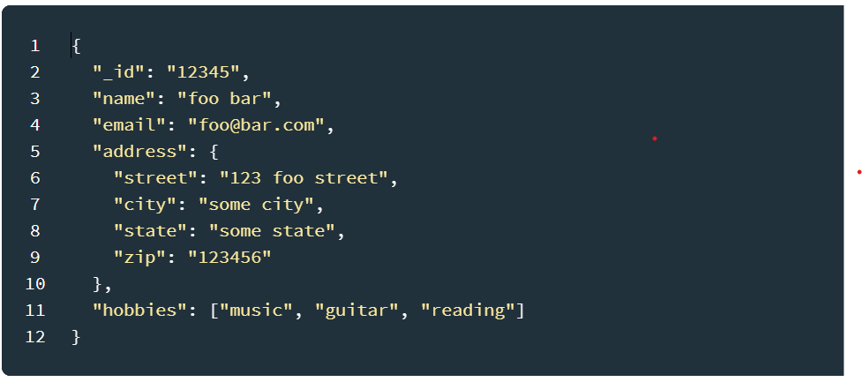
Structure
No - SQL
Document Database
How do we store more than one.

Slide 9
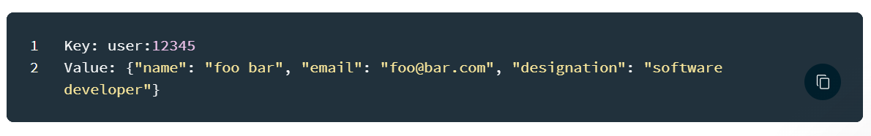
Structure
No - SQL
Key-value Database
How do we store more than one.

Slide 10
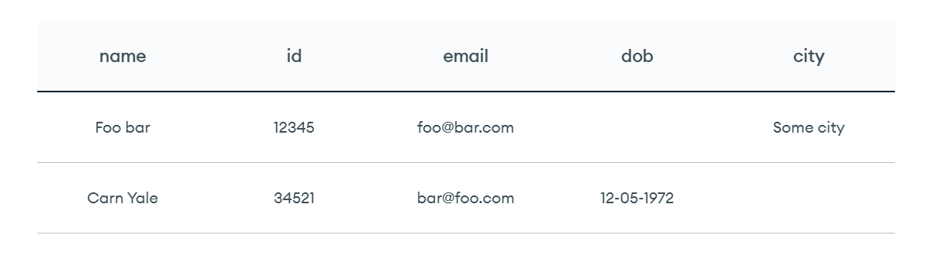
Structure
No - SQL
Wide-column stores
How do we store more than one.

Slide 11
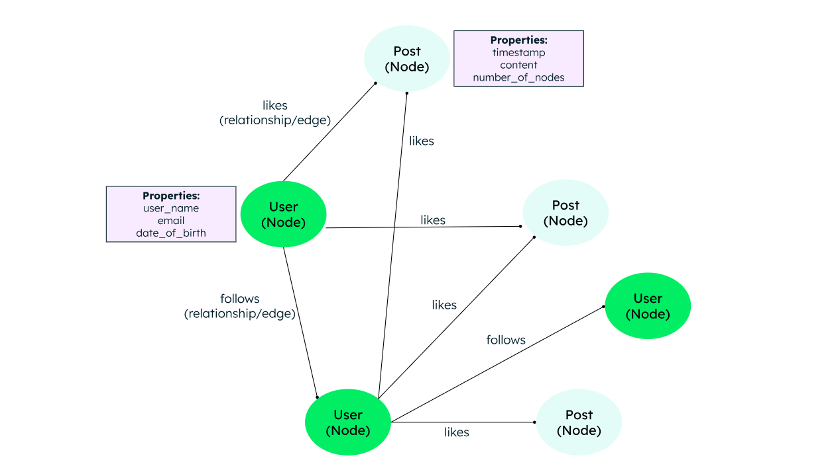
Structure
No - SQL
Graph Database
How do we store more than one.

Slide 12
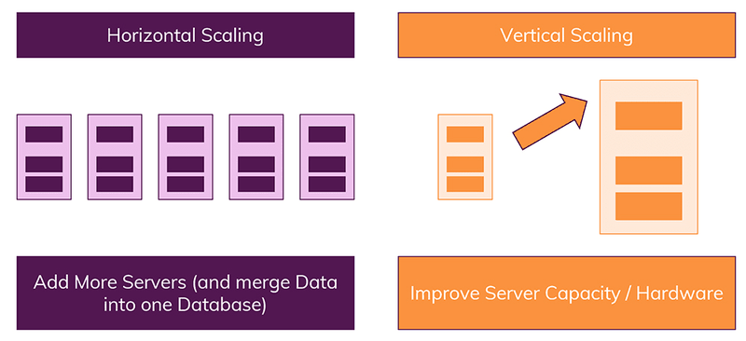
Scaling
Vertical Scaling means that we simply increase the power of the database server - e.g. by upgrading its CPU.
Horizontal Scaling on the other hand means that more servers are added and the database is distributed across them. Hence you still work with one database but multiple servers that host it.

Slide 13
Add More Servers (Scale-Out): The core of NoSQL; add inexpensive machines to the cluster to increase capacity.
Data Modeling: Store related data together in a single document (denormalization) to avoid complex joins, optimizing for quick key-based lookups.
Caching: Use in-memory caches (like Redis) to reduce database load for frequently accessed data.
Cloud-Native Auto-Scaling: Services like AWS DynamoDB, Azure Cosmos DB, and MongoDB Atlas offer automated resource adjustments.

Slide 14
In this CWB Circle
  I will be using Microsoft SQL Server - Developer Edition
  https://www.microsoft.com/en-us/sql-server/developer-tools
  Mongo DB or Azure Cosmos DB
  Questions for next meetup
    Will be sent through whatsapp
      Write a simple T-SQL on SQL Server.
      Define types of relationships with examples.
      Whats DDL and DML?

